Slide 1

APARTMENT MANAGEMENT SYSTEM

Slide 2


TEAM MEMBERS
RAKSHANNA KANTHAN(RA2011003010145)
GUNNU JAIRAJ(RA2011003010171)
ANUPAM PALAI(RA2011003010206)

Slide 3


ABSTRACT
WEBSITE FOR APARTMENT MANAGEMENT fulfills the requirements of residents and facilitates car parking by utilizing of car parking Area. The auditorium can be booked for the events conducted in the apartment based on the availability of the hall. We are also trying to utilize the available parking facility inside the premises. Many car parking slots will be vacant when The owners go to their work. So the owners can mention the availability of their slots so that the gatekeeper will know those slots and based on this the Parking can the managed. Technical issues faced by residents are solved by admin assigning workers for the complaints registered by users online payments are also facilitated through this web application

Slide 4




OBJECTIVE
The apartment Management System is used to help people in the apartment pay bills such as maintenance bills, and water bills, make a complaint, allot parking slots and update tenants' information.

Slide 5

To know what the problem is and what the needs are before developing it. Here we design a website for Apartment management for managing the requirements of apartment residents, which is not need to be done manually and by maintaining records.
PROBLEM STATEMENT

Slide 6



The main purpose of this website is to create a website for apartment management. The benefit of this website is very high because the people related to apartments can use this website for the management of apartments for years.
PURPOSE

Slide 7
SCOPE
Our project has made it easier for apartments to manage residents easily and systematically. In the future we would like to add a provision for booking the auditorium for conducting more than an event a day without collision we would also like to update the web application with added features like online shopping for groceries and bill payments

Slide 8
Specific Requirements
Operating System:Windows10
Languages used: PHP
Database : MySql
Technologies used: HTML,Javascript,CSS,HTML5,CSS3

Slide 9
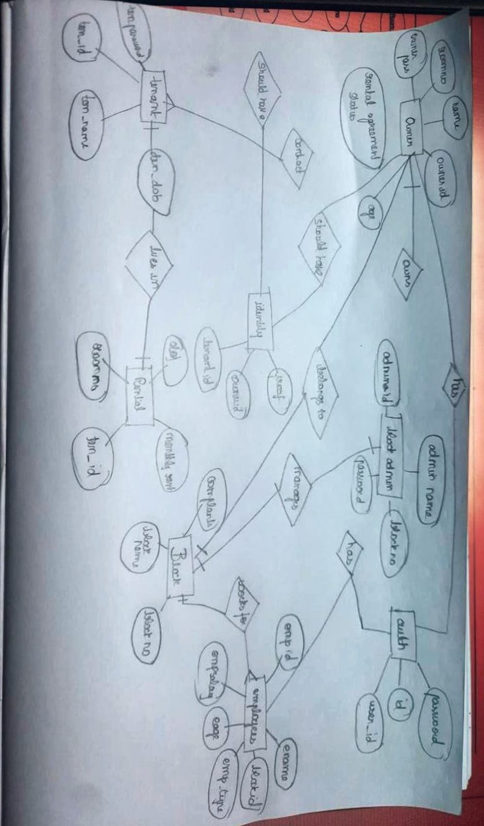
Er diagram

Slide 10

Thank you

